Slide 1
Government bond market development in CEMLA countries
Centro de Estudios Monetarios Latinoamericanos
September 2019

Slide 2
Government bond market development in CEMLA countries
Over the past decades, government bond markets in local currency have developed substantially along the emerging economies. During this time, some markets have evolved from being closed, with few types of securities, to being liquid and deep, with broader investors’ base and extended maturities, that allow governments access to better funding conditions.
To achieve this, economies have to go through a consolidation process in their macroeconomic fundamentals, financial stability, along with a robust legal, tax and regulatory framework and improvements in the implementation of government policies, in order to make investments in local assets less risky and more attractive.
  The first condition is consolidating the process of macroeconomic stabilization, with an improvement of public finances and fiscal consolidation.
  In terms of monetary policy, macroeconomic stabilization involved attaining low inflation rates.
  Other modifications that help the efficiency of a fixed income market are improvements in local payment systems.
However, the degree of progress among economies has been heterogeneous, and some countries are still far away of having developed debt markets, due to a lack in specific characteristics. According to the World Bank, “an efficient government securities market is characterized by:
  A competitive market structure
  Low transaction costs
  Low levels of fragmentation
  A safe and robust infrastructure,
  and a high level of heterogeneity among participants

Slide 3
Government bond market development in CEMLA countries
The amount of debt outstanding differs substantially over economies, being the developed markets the biggest ones. These economies reflect better financial stability conditions, as well as better debt policy management strategies, and sound fiscal policies that generate conditions for debt sustainability.
World debt markets
Millions of US dollars
Latin America debt markets
Millions of US dollars
Source: Bloomberg.
Source: Bloomberg.

Slide 4
Government bond market development in CEMLA countries
As sovereign debt markets turn deeper and more liquid, governments can extend the duration of their portfolios by issuing debt with longer term maturities.
Yield curve in Latin American economies
Percentage
Source: Bloomberg.
Data for September 4th, 2019

Slide 5
Government bond market development in CEMLA countries
According to data from the Emerging Markets Traders Association (EMTA), Latin America constitutes the emerging region with the most traded volumen for fixed income securities. Within this region, securities from Mexico and Brazil are the most traded.
Traded volumeoffixedincomesecurities in emerging markets
Billions of US dollars
Traded volumeoffixedincomesecurities in Latam economies
Billionsof US dollars
Source: EMTA.
Source: EMTA.

Slide 6
Government bond market development in CEMLA countries: Mexico
The Mexican fixed income market has showed a significant development over the last two decades. During this time, the market evolved from being closed and with few types of securities, to one of the most liquid and deep debt markets in the emerging economies with several instruments available for trade.
Moreover, maturities for most securities have extended significantly, from one year to up to thirty years in nominal and real terms, and to 100 years in international markets . Investor base has also expanded dramatically, evolving from only money market funds and banks to institutional and foreign investors. In addition, issuers base has expanded. Currently the market is not only tapped by the Federal Government; corporate bond placement, including international issuers has grown in an important way.
The ability to achieve these changes in such a short time is the result of a joint effort between the Federal Government and the Central Bank, who have focused in strengthening Mexico’s macroeconomic fundamentals and providing stable financial markets with a robust legal, tax and regulatory framework in order to make investments in local assets less risky and more attractive.
The first condition was to consolidate the process of macroeconomic stabilization, which was supported by the fiscal and monetary policies adopted since the 1980s. It was essential to improve public finances and achieve their sustainability. The public sector deficit was reduced from 7% of GDP to a level between 1 and 2%. The consolidation of fiscal discipline has been a fundamental pillar for the development of the public debt market. Domestic and foreign investors are reluctant to purchase government debt instruments, particularly those at mid and long terms, if there is a considerable credit risk, a restrictive regulatory framework, a complex and barely transparent fiscal regime, high inflation expectations or considerable volatility in exchange rates.

Slide 7
Government bond market development in CEMLA countries: Mexico
In terms of monetary policy, macroeconomic stabilization involved the adoption of an autonomous central bank (1994), and an inflation targeting framework in 2002. This strategy allowed the Central Bank of Mexico to reduce inflation significantly, until the achievement of inflation to levels within the central banks objective which is 3%. The development of domestic debt markets is particularly relevant for the Central Bank, as it enables the use of short term interest rates to convey monetary policy signals across the whole maturity spectrum, making the debt market an integral part of the monetary policy transmission channels.
In addition, several national reforms had to be implemented, such as:
  A robust development of the FX market
  Open capital account
  Reforms to the pension system law
  Improvements in local payment systems, including the implementation of Delivery vs Payments system

Slide 8
Foreign Exchange Market
In December 1994, the floating Exchange rate system was adopted and since then a lot of efforts were carried out from financial authorities in order to assure a deep and liquid market. Today the currency is fully deliverable and trades 24/7, a characteristic that not many EM currencies share.
Since the introduction of the free-floating regime in the Foreign Exchange market, the Foreign Exchange Commission has allowed the Exchange rate to act as the main buffer against external shocks.
  The interventions made by Mexican authorities have sought to preserve the correct behavior of the Mexican Foreign Exchange market.
  Mexican authorities´ intention has been that the interventions are carried out through previously announced mechanisms and rules and never looking to preserve a particular level for the exchange rate.
The mechanisms and instruments used in the last 10 years, are:
    US dollar sale auctions (2008-2009 and 2014-2016)
      With and without minimum price
      Scheduled and non-scheduled
    Put option auctions to sell US dollars to Central Bank of Mexico (2010-2011)
    US dollar credit auctions (2009)
    US dollar Non Deliverable Forwards (NDF) auctions (2017-2018)
    Discretionary interventions in the Foreign Exchange Market (February 2009, February 2016 and January 2017)

Slide 9
Foreign Exchange Market
Mexican FX market is one of the most liquid from the emerging market.
Daily trade volume by currency in spot market during April 2013 and April 2016
Daily average, billions of US dollars
Mexican Peso total turnover in the foreign exchange market
Daily average, billions of US dollars
Mexican peso trading turnover
Daily average, billions of US dollars
Source: BIS Triennial Central Bank Survey, Federal Reserve FXC Survey, Bank of England FXJSCSurvey and Central Bank of Mexico.
Note: For April 2010, April 2013 and April 2016 the data is from the triennial BIS survey, other volumes are estimated using the data provided by the Central Bank of Mexico , FXC and FXJSC surveys without the intersection between these markets in order to avoid double counting.
Source: BIS Triennial Central Bank Survey, Federal Reserve FXC Survey, Bank of England FXJSCSurvey and Central Bank of Mexico .
Source: BIS Triennial Central Bank Survey .

Slide 10
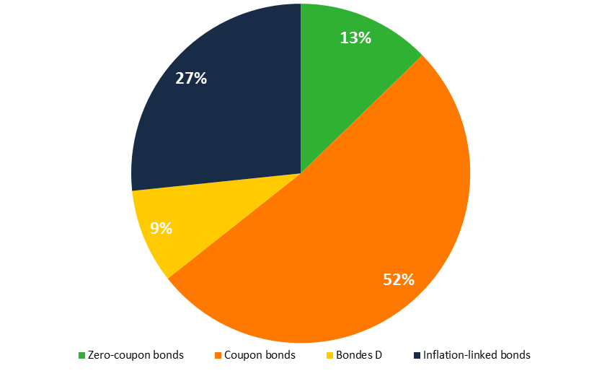
Government bond market development in CEMLA countries: Mexico
Federal Government debt composition
Percentage
Federal Government debt composition
Percentage
December 1999
September 2019
Note: Total amount outstanding is 549,154 million mexican pesos.
Source: Central Bank of Mexico.
Note: Total amount outstanding is 7.2 billion mexican pesos.
Source: Central Bank of Mexico
Source: SHCP.

Slide 11
Government bond market development: Money Markets
The first necessary step for the development of alocal debt market is to have a deep and liquid short term market (money market), with several participants, since this market influences the fixed income market, by increasing the liquidity of the securities.
In Mexico, the repo market posses these characteristics, and it also represents an important benefit for the Bank of Mexico, since it helps in the monetary policy instrumentation and the open market operations.
Daily trading volume in bank and government securities funding
Millions ofpesos
Difference between the interbank funding rate and the reference rate
Basis points
Source: Central Bank of Mexico.
Source: Central Bank of Mexico.

Slide 12
Government bond market development
The first issuance of Bonos M (coupon bonds) was in 2000, with a maturity of three years. Over the following years, the Federal Government continued developing the local yield curve development, until, in 2006, they issued the first 30 year bond. The extension of government securities duration has provided many benefits for the Federal Government, such as:
  Decrease continuous portfolio rebalancing due to changes in interest rates
  Reduce the rollover risk for the Federal Government
Evolution of Mexican yield curve
Percentage
Average maturity of Government securities
Years
2019
Source: PIP.
Source: Central Bank of Mexico

Slide 13
Local Market Microstructure: Market Makers Program
As a further step to develop Mexico’s debt markets and promote the liquidity of the secondary market, the Mexican Ministry of Finance established in 2000 a market-making program for government bonds. The program was initially established for MBonos and Cetes (nominal instruments). It was until 2008 that the program was also extended to Udibonos (Inflation-linked bonds).
Market makers: credit institutions and brokerage firms –appointed by the Ministry of Finance– conferred with the obligation of participating very actively in the fixed-rate government securities market.
Market makers are expected to comply with healthy practices and establish trading mechanisms to carry out transactions among each other. Throughout the program, 13 institutions have acquired a market-maker status, which is acquired per request of the institution, after fulfilling certain criteria. This number has diminished as some institutions have merged and others left. The maximum amount of institutions with such status at the same time has been of 10 from 2007 to 2008, and the minimum has been 5 in 2001 and 2002.
Currently, there are seven market-makers for Cetes and MBonos that have around 75% of the total market share. There are also four market-makers for Udibonos that account for 55% of the total market share.
Rights
“Green shoe” option
Securities lending facility
Duties
Commitment to participate in primary auctions
Present quotes (both for bid and offer) for each of the securities they are market makers of, in all their maturities.
Declare their interest in participating in the program
Active participation in primary and secondary markets
Market share ≥ 7%
Eligibility
Access to syndicated security auctions
Comply with the Code of conduct for the money and fixed income market

Slide 14
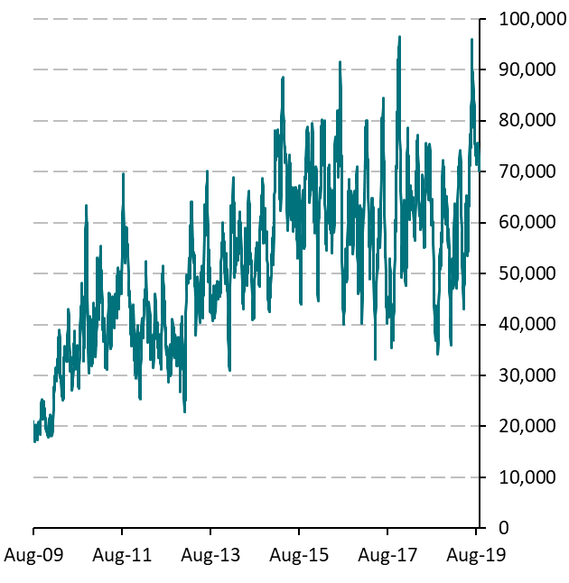
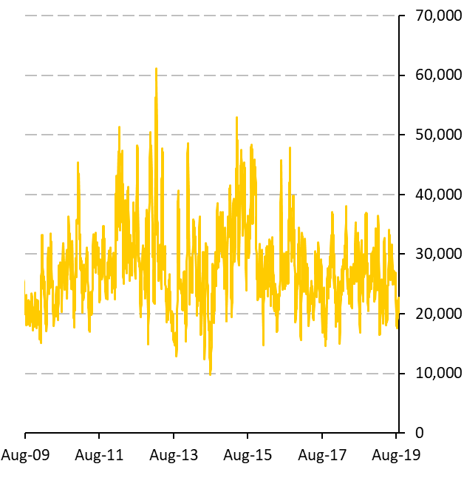
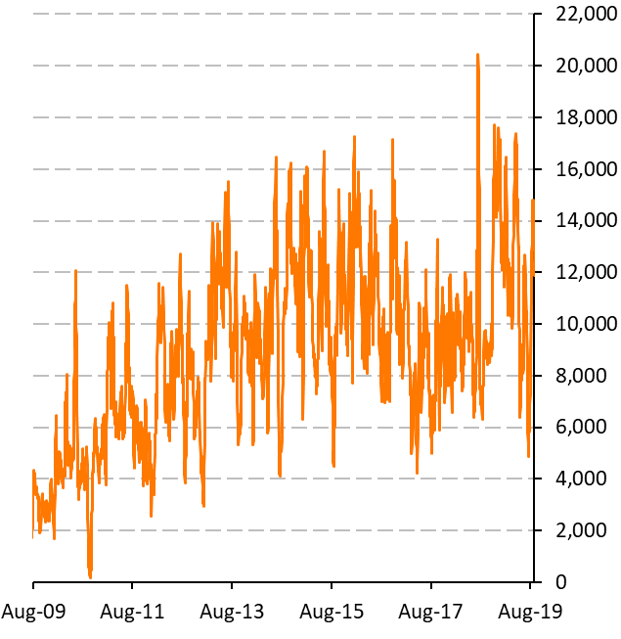
Local Market Microstructure: Secondarymarket
One of the main characteristics of a competitive market structure is having a deep secondary market, fostering the price discovery for all market participants.
Daily trading volume in Mexican government M bonds
Millions of pesos (10-day moving average)
Daily trading volume in Mexican government Zero-coupon bonds
Millions of pesos (10-day moving average)
Daily trading volume in Mexican government Inflation-linked bonds
Millions of pesos (10-day moving average)
Source: Central Bank of Mexico.
Source: Central Bank of Mexico.
Source: Central Bank of Mexico.

Slide 15
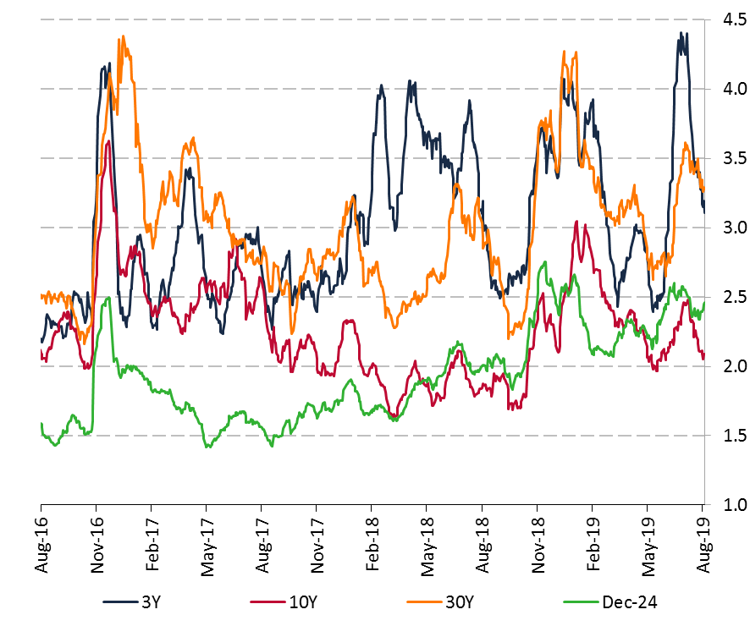
Local Market Microstructure: Secondary market
MBonos bid-ask spread for selected maturities
Basis points(20 days moving average)
Government securities lending costs
Percentage of funding rate
Source: Central Bank of Mexico.
Source: Central Bank of Mexico.

Slide 16
Local Market Microstructure: Secondary market
In Mexico, government securities can be traded in two ways: throughbrokers or through phone .
The electronic platforms development has been crucial to facilitate trading among participants, since it facilitates trading between participants, generating almost immediate access, and providing information regarding the Price Discovery process.
Market participants
Government securities operation by market
Percentage
Source: Ministry of Finance..
Source: Central Bank of Mexico.

Slide 17
Local Market Microstructure: Secondary market
Having Low levels of fragmentation is essential for creating liquidity and developing benchmark bonds, since narrowing the variety of debt instruments available in the market consolidates and standardizes government securities issuances.
Available bonds M issues for trading
Number of bonds outstanding
Outstanding amount of government securities in the market
Percentage of total outstanding
Source: Central Bank of Mexico
Source: Central Bank of Mexico
Notes:
A fragmented debt structure hinders fungibility and reduces the size and trading volume of benchmark issues and disperses market liquidity over many issues.

Slide 18
Local Market Microstructure developments
Issuance Calendar: Announced quarterly by the Federal Government, specifies the instruments to be issued and placed in each weekly auction. Announced jointly with other public entities issuance (such as Banco de México and PEMEX)
Auction Rules: The Government Securities Auction Rules have been adjusted several times to improve the efficiency of the allocation process
Issuance reopening policy: Policy focused in create faster size benchmark and minimize the number of securities
Strips market: Allows market participants to strip any of the existing fixed rate government securities, enhancing the depth of secondary markets
Liability management operations: Operations aimed at reducing the financing cost of public debt and maintaining an adequate risk level. Those operations are either performed in domestic or international markets.
Syndicated auctions: in 2010, the Federal Government decided to implementa new format for debt placements, though syndicated auctions with the Market Makers, in order to provide more liquidity for benchmark bonds.

Slide 19
Local Market Microstructure: Participants heterogeneity
A high level of heterogeneity among participants is an attribute that is needed for an efficient market, as it increases liquidity, makes debt markets more attractive, and therefore increases the investor base.
These measures described above improved substantially the depth and liquidity of the market, allowing the inclusion of local government securities in several Global Fixed Income Indexes. As a result, the investor base for government securities changed, switching from local participants and retail investors, to foreign and institutional investors who use these indexes as benchmarks.
Investors Position in Government securities denominates in Mexican pesos
Percentage of Government securities outstanding
Source: Ministry of Finance.
Source: Central Bank of Mexico.

Slide 20
Investor Base: Pension Funds (Siefores)
In 1997, the pension system for private sector employees was amended from a pay as you go scheme, to a defined contribution structure based on individual accounts managed by private funds known as Afores.
Since then, the Mexican Pension System (SAR) through the Afores, has been a paramount player in developing the local debt market.
As of July 2019, pension funds manage MXN 3,727,312 million (USD 191,144 million)
Pension Funds assets under management
Billions of Mexican pesos
Source: CONSAR.

Slide 21
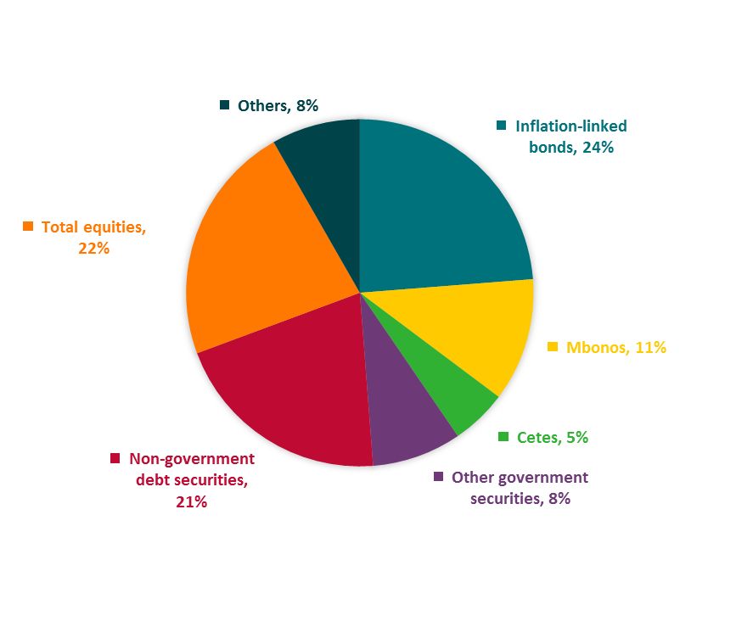
Investor Base: Pension Funds (Siefores)
As the market evolved into longer-term instruments and different types of rates (real and variable), the Siefores became relevant market participants. Due to their investment, risk and performance profile, they are currently the dominant player in the Udibonos market, or real-rate instruments.
Total Pension funds portfolio composition
Percentage of total exposure
Holdings of Udibonos by investor type
Percentage of total outstanding
Note: Data as of June 2019
Source: CONSAR.
Source: Central Bank of Mexico

Slide 22
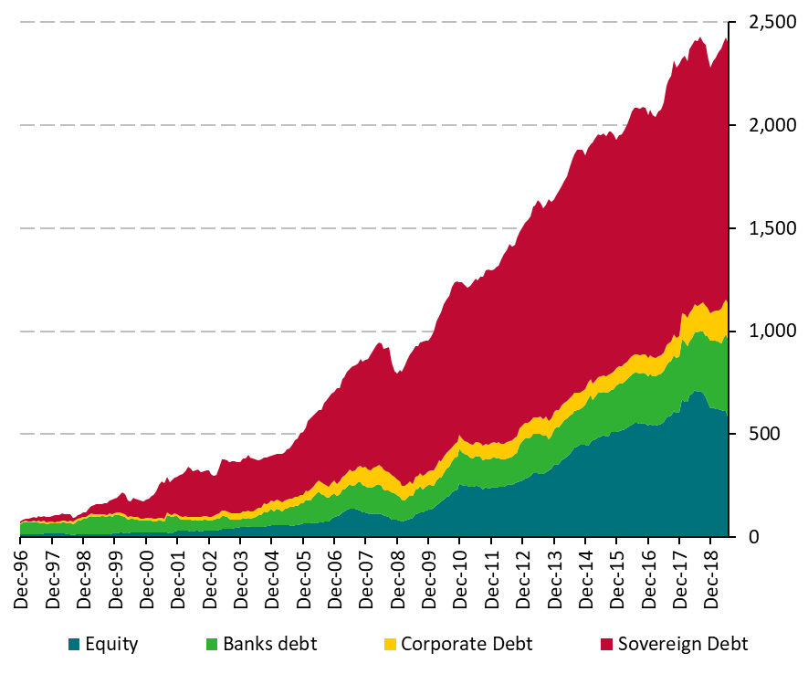
Investor Base: Local Mutual Funds
Mutual or Investment funds assets under management have been growing in line with the development of the local market.
By nature, they are focused on short term investments, therefore more than 75% of their portfolio is composed of these type of assets.
Investment Funds’ Assets Under Management
Billions of Mexican pesos
Investment funds’ Assets Under Management
Billions of Mexican pesos, percentage of the AUM
Source: CNBV.
Source: Central Bank of Mexico

Slide 23
Investor Base: Local Mutual Funds
Regarding investment funds’ holding of Government securities, most of their holdings are constituted by variable rate bonds, such as Bondes D and IPAB securities. The rest of the Government portfolio mainly consist of inflation-linked bonds (udibonos), Zero-coupon bonds (cetes) and fixed-rate bonds (Bonos M).
Investment Funds’ Holdings of Government securities
Billions of Mexican pesos
Source: CNBV.

Slide 24
Investor Base: Foreign Investors
Foreign investors Mexico have become one of most important local market participants since this market offer a friendly fiscal scheme and no restrictions for the entrance and exit of foreign capitals.
Additionally, the sound macroeconomic foundations, the responsible management of public finances, and the development of financial markets have contributed foreign investors to increase local denominated government positions, mainly in Bonos M.
Non-Residents’ Holdings of Government securities
Billions of Mexican pesos
Non-Residents’ Holdings of Government securities
Percentage of total outstanding
Source: Central Bank of Mexico
Source: Central Bank of Mexico

Slide 25
Derivatives Markets
The development of the government debt market in Mexico has also fueled the emergence of the derivatives market.
Having a consolidated derivatives market sets the basis for adequate risk management. Another benefit is that this market is having better financial tools and indicators for the central bank to evaluate market expectations. Moreover, having these derivatives available for trading gives market participants resources to efficiently hedge interest rate risk.
TIIE IRS’ Daily Turnover
Billions of pesos (20-day moving average)
TIIE IRS’ Daily Turnover
Billions of pesos (20-day moving average)
Source: DTCC. SEF: Swap execution facility.
Source: DTCC and Central Bank of Mexico

Slide 26
Other Fixed Income Markets
The development of the government securities market has positive consequences for other fixed income markets, such as the corporate bond market. Someprivate corporates, besides enjoying access to credits through the bank sector, have managed to finance productive projects by issuing bonds and securitizing assets. In fact, the yield curve is the main anchor for floating-rate issues, the most common instrument for corporate issues.
Corporate debt and Quasi-government debt classified by maturity
Percentage
Corporate debt and Quasi-government debt classified by credit rating
Billions of pesos
Source: Central Bank of Mexico.
Figures as of July 31st, 2019.
Source: Central Bank of Mexico.
Figures as of July 31st, 2019.

Slide 27
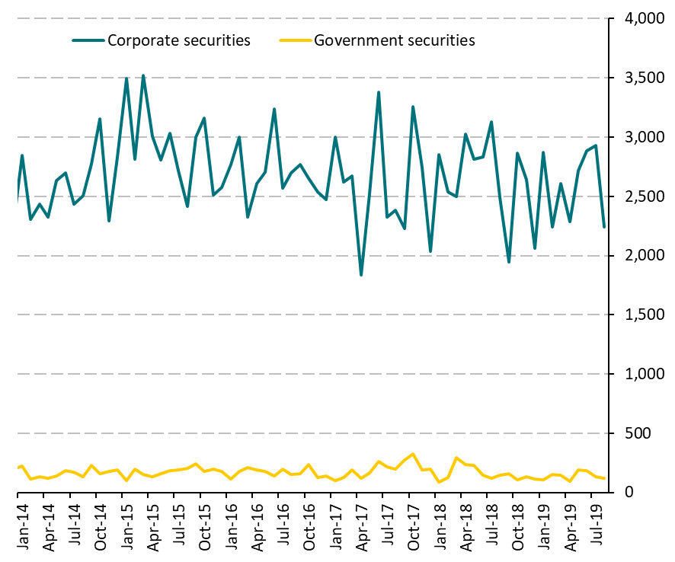
Challenges: Corporate Fixed Income Market
Additionally, there is an important challenge regarding the corporate debt market in Mexico. This market’s primary and secondary activity is practically null, and far from what is observed in other emerging markets. The benefits of developing this market include:
Provide the investors with more tradable securities with attractive returns and therefore, an increase in foreign inflows.
Allow local corporates to access additional financing channels with lower costs.
Create an attractive operation framework, so that international corporates issue their debt in the local market.
Improve the operations conditions for this market, as well as the availability of information for a better “Price-finding” process. In this regard, in 2015, the Ministry of Finance and Nafin, a development bank, launched a primary auction platform for these securities issued with a fixed rate, in order to improve the liquidity in the secondary market.
Monthly Trading Volume in Mexican Debt with Local Banks
Billions of pesos
Source: Banco de Mexico.

Slide 28
Conclusions
The Mexican fixed income market has achieved an important development in the last two decades.
The combination between stability and financial reforms had a positive impact in the financial system savings, which doubled, as a percentage of GDP, during 15 years. The pension funds role in the market became more important , toa point that they are now the most important institutional investor in government securities. As mentioned throughout this presentation, havinga broad investor base has helped to maintain the stability and liquidity in local financial markets.
These achievements have been possible because of the persistence of prudent monetary and fiscal policies, and the appropriate legal and regulatory frameworks.
In addition to the afore mentioned benefits, other advantages associated with a developed local debt market are:
  To provide more financing alternatives for both the Federal Government and the private sector, reflected in lower financing costs, compared to alternative financing vehicles, such as banking credits of external debt issuances.
  To have a broader investor’sbase with investments alternatives that are appropriate to their preferences.
  To generate reference rates that can be used for the valuation of other financial products valuation.

