Slide 1
Primary Dealer Systems in Government Securities
Juan Rafael García Padilla, Director of Domestic Operations, Banco de México
September, 2019

Slide 2
1
  Definition, characteristics and advantages of a Primary Dealer System
2
  Selected countries’ experience
3
  Primary Dealers System in Mexico

Slide 3
Definition, characteristics and advantages of a Primary Dealer System
What is a Primary Dealer System?
A primary dealer system is an agreement between a debt management office and a group of institutions to pursue a common strategy in support of the functioning and development of primary and secondary markets for government securities.¹
Generally, with their status of Primary Dealers, institutions gain specific privileges and are subject to certain specialized functions or obligations within the government securities market.
Main objectives of a Primary Dealer System
Building a stable source of demand for securities in the primary and secondary markets.
Providing liquidity in the secondary market, fostering efficient price formation.
Building distribution channels and expanding the investor base, as primary dealers often act as intermediaries.
Promote public confidence in the integrity of the government securities market.
1/ “Primary dealers in government securities”, Marco Arnone and Piero Ugolini, Washington, D.C. , International Monetary Fund, 2004.

Slide 4
Potential advantages and disadvantages of implementing a Primary Dealer System
Disadvantages
Advantages
Can potentially limit competition, as primary dealers acquire certain rights or advantages over other institutions.
1
Increases and ensures coverage at primary auctions.
1
2
Improves secondary market conditions.
Requires regular measuring and monitoring to ensure compliance.
2
For markets in an early development stage, a PD system can help ensure the development and proper functioning of the secondary market.
Possible misconception of debt manager guaranteeing creditworthiness.
3
3
Can improve government access to financing as it can foster efficient price formation in the secondary market.
4
5
In some cases, it facilitates the implementation of monetary policy.

Slide 5
1
  Definition, characteristics and advantages of a Primary Dealer System
2
  Selected countries’ experience
3
  Primary Dealers System in Mexico

Slide 6
Selected countries’ experience: Development of Primary Dealer Systems
Year of Establishment of a Primary Dealer System
Source: Finance ministries, central banks and other national authorities.
Note: If the country appears more than once it is because there were important changes in their primary dealer system. The size of the circle represents the number of primary dealers in each country.

Slide 7
Selected countries’ experience: Selection criteria, obligations and rights
The selection criteria for primary dealers is related to their role in the primary and secondary markets for government securities, it also depends on the development of the country’s domestic financial market.
Rights are arrangements that should allow the primary dealers to perform efficiently and obligations are the commitments they make to perform certain activities.
Source: Finance ministries, central banks and other national authorities.

Slide 8
Selected countries’ experience: Relationship with the authorities
The arrangement between primary dealers and authorities must be transparent and responsibilities clearly defined. A continuous flow of communications among the ministry of finance, the central bank, and primary dealers is essential.²
Institutions Responsible for Supervision and Enforcement
Recommendation of a Primary Dealer System
Source: Finance ministries, central banks and other national authorities.
Note: A survey questionnaire on primary dealers was sent by the IMF to 47 countries. Of the 39 respondents, 20 were advanced economies, 13 were emerging markets, and 6 were developing countries.
Source: IMF staff survey of national authorities (2001).
2/ “Primary dealers in government securities”, Marco Arnone and Piero Ugolini, Washington, D.C. , International Monetary Fund, 2004.

Slide 9
1
  Definition, characteristics and advantages of a Primary Dealer System
2
  Selected countries’ experience
3
  Primary Dealers System in Mexico

Slide 10
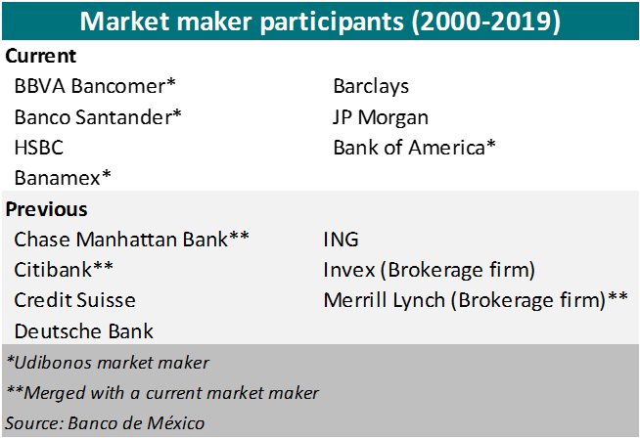
Primary Dealers System in Mexico
As a further step to develop Mexico’s debt markets and promote the liquidity of the secondary market, the Mexican Ministry of Finance established in 2000 a market-making program for government bonds.
The program was initially established for MBonos and Cetes (nominal instruments). It was until 2008 that the program was also extended to Udibonos (Inflation-linked bonds).
Throughout the program, 13 institutions have acquired a market-maker status. This number has diminished as some institutions have merged and others left. The maximum amount of institutions with such status at the same time has been of 10 from 2007 to 2008, and the minimum has been 5 in 2001 and 2002.
Currently, there are seven market-makers for Cetes and MBonos that represent around 75% of the total market share. There are also four market-makers for Udibonos that account for 55% of the total market share.

Slide 11
Primary Dealers System in Mexico: Characteristics
Selection Criteria
Declare their interest in participating in the program
Active participation in primary and secondary markets
Market share ≥ 7%
Obligations
Privileges
Primary Market Participation
Commitment to participate in primary auctions.
Secondary Market Participation
Provide two-way quotes for each of the securities they are market makers of, in all their maturities.
Comply with the Code of Conduct
Comply with the Code of Conduct for the money and fixed income market.
“Greenshoe” option
The right to buy up to an additional 20% of the Fixed-rate securities offered in the primary auction.
Securities lending facility
Borrowing privileges with the Central Bank.
Syndicated auctions
Exclusive access to syndicated auctions where they act as distributors.

Slide 12
Primary Dealers System in Mexico: Characteristics
Market Maker Index (Zero-coupon and MBonos) = Activity Index + Incentives - Penalizations
Market Maker Index (MMI)
Activity Index
(AI)
Incentives and Penalizations
Zero Coupon bonds
3%
MBonos
97%
Primary Market
100%
Primary Market
25%
Secondary Market with Institutional Clients
40%
Interbank Secondary Market 35%
Diversification Index
Operations in Mexican Derivatives Market
Two-way quotes in secondary market
Quotes
Operation Volumes
Market Maker Index (Inflation Linked Bonds) = Activity Index + Incentives - Penalizations
Market Maker Index (MMI)
Activity Index
(AI)
Incentives and Penalizations
Two-way quotes in secondary market
Secondary Market with Institutional Clients
40%
Primary Market
35%
Interbank Secondary Market
25%
The Market Maker Indexes are calculated every month with a six month period.

Slide 13
Primary Dealers System in Mexico: Characteristics
“Greenshoe” Option
Market makers are obligated to participate in primary auctions, by providing a minimum amount of bids. By complying with this obligation, market makers gain access to a “greenshoe” option.
In the “greenshoe” option, market makers have the option to buy, in total, up to 25% of every issue offered in the primary auction a day before (depends of the type of instrument they are market makers of), at the same allocation price.
Advantages for issuer
Advantages for market makers
Allows the debt manager to increase the allotted amount of debt.
1
Depending in market conditions, the market makers have the opportunity to buy an additional amount of instruments at a lower price than the one in the secondary market.
1
The additional debt is allotted at the same price of the primary auction, eliminating any risk related with less competitive pricing dynamics.
2
Allows market makers to meet large demand from clients that could not be fulfilled through the primary auction.
2
3
Makes the program more attractive.

Slide 14
Primary Dealers System in Mexico: Characteristics
“Greenshoe” Option
Allocation in “greenshoe” option as percentage of amount offered
Percentage
For Zero-coupon bonds, 94.3% of the times the option is partially or completely exercised.
*Data since 2001
For Mbonos, 60.3% of the times the option is partially or completely exercised.
*Data since 2001
For Inflation-linked bonds, 49.6% of the times the option is partially or completely exercised.
*Data since 2008
Source: Banco de México.

Slide 15
Primary Dealers System in Mexico: Characteristics
Participation in the Secondary Market
Another obligation for market makers is being active in the secondary market by providing competitive two-way quotes through brokers.
Market makers must present competitive quotes for each of the securities they are market makers of, in all their maturities.
If market makers comply with a minimum amount of quoted amount, they are granted with a basis points incentive (maximum 90bp) which will be added to their market share. In the contrary , if they fail to comply with the minimum amount, they are penalized with basis points that will be subtracted from their market share (maximum 30pb).
Competitiveness →
Competitive quotes, measured by the difference between the quoted rate and the rate in the two adjacent trades, weighted by the time elapsed between the quote and the trades.
Minimum Lifespan →
Quotes live for more than 1 minute.
Minimum amount →
More than 20 million pesos in quotes for every issuance of the instruments the institution is market maker of, in a daily basis.
Incentives are defined by the daily average of the percentage of issuances that comply with the 20 million pesos requirement, in a monthly period.

Slide 16
Primary Dealers System in Mexico: Characteristics
Participation in the Secondary Market
Daily quoted amount for Mbonos by type of institution
Millions of pesos (Moving average 20 days)
Daily average of the quoted amount for Mbonos in 2019 by maturity
Millions of pesos
Intraday Quotes in August 19, 2019 for the Mbono maturing in Dec-24
Percentage
Source: Banco de México.
Source: Brokers
Source: Brokers
Note: The size of the sphere represents the amount quoted.
Source: Brokers

Slide 17
Primary Dealers System in Mexico: Characteristics
Participation in the Secondary Market
Daily quoted amount for Udibonos by type of institution
Millions of pesos (Moving average 20 days)
Daily average of the quoted amount for Udibonos in 2019 by maturity
Millions of pesos
Intraday Quotes in August 19, 2019 for the Udibono maturing in Jun-22
Percentage
Source: Brokers
Source: Brokers
Note: The size of the sphere represents the amount quoted.
Source: Brokers

Slide 18
Primary Dealers System in Mexico: Characteristics
Securities lending facility
Market makers have borrowing privileges with the Central Bank. They have access to a Mbonos, zero-coupon bonds and inflation-linked bonds lending facility even if they act as market makers of that particular instrument or not.
The right to the securities lending facility is suspended for those market makers with positions for a single issue of Bonos or Udibonos that exceed 35% of the amount placed in each issue.
In order to foster the development of securities lending in the secondary market, in October 2007, the cost for the securities lending facility was adjusted and stablished as a function of each market maker’s securities lending activity in the market, with different participants than the Central Bank.
The cost of Cetes and Bonos lending for market makers varies by participant:
  For a market maker in a particular instrument, the cost of lending is a percentage of the government funding rate. The cost represents between 3% and 7% of the government funding rate.
  For an institution that is not a market maker of that particular instrument, the facility is also an option but the cost is 100% of the funding rate.
Advantages for market makers
1
Immediate disposition of any government security.
2
Possibility of fulfilling a client’s demand for Mexican securities immediately.
3
Ease in compliance with the duty of continuously quoting purchase and sale prices for fixed-rate government securities in the secondary market.

Slide 19
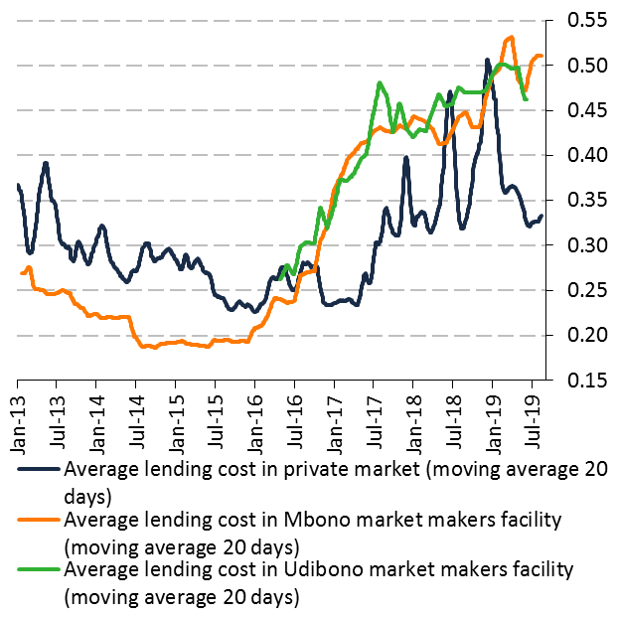
Primary Dealers System in Mexico: Characteristics
Securities lending facility
Government securities lending costs
Percentage of funding rate
Securities lending facility as percentage of the limit by instrument (capacity)
Percent
Foreign investors bond flows and securities lendings bond flows for MBonos
Millions of pesos (20-day moving average)
Source: Banco de México.
Source: Banco de Mexico.
Source: Banco de Mexico.

Slide 20
Primary Dealers System in Mexico: Characteristics
Incentives for operations in Mexican Derivatives Market
Within the eligibility criteria in the Market Maker Index for Mbonos and Cetes, is the operations in the Mexican Derivatives Markets (MexDer), which is the institution authorized by the Mexican Ministry of Finance in charge of providing the facilities and services needed so the derivative contracts are quoted and negotiated.
Market Maker Index (MMI)
Incentives and Penalizations
Operations in Mexican Derivatives Market
The points for activity in the derivatives market are calculated as follow:
Points for competitive quotes + Points for operated contracts
  Up to 70 basis points for competitive quotes in Mbonos and zero-coupon bonds future contracts.
  Up to 40 additional basis points if the institution operates 40,000 or more future contracts.

Slide 21
Primary Dealers System in Mexico: Development and Contributions
Market makers have contributed both to make the primary market of securities more efficient and sophisticated and to develop the securities’ secondary market. When the Market Maker Program was first implemented in 2000, the government domestic financing revolved around short-term instruments and floating-rate coupon bonds. Likewise, the level of domestic debt placed through market instruments accounted for only 8% of GDP.
At the beginning, the Market Maker Program considered only Cetes and 3-year fixed rate nominal bonds created in January of 2000. In May, a 5-year bono was placed. In tandem with the development of the Market Maker Program, the maturities of fixed rate placements extended to 10, 20 and 30 years, respectively. At the end of 2013, and having the entire fixed rate yield curve developed, these instruments accounted for 53% of the total amount of government securities and 23% of GDP.
Yield Curve development
Development of domestic government debt securities
Percentage
Evolution of Mexican yield curve
Percentage
Average maturity of Government securities
Years
Cetes
MBonos
Source: Banco de México.
Source: Banco de México.
Source: Banco de México.

Slide 22
Primary Dealers System in Mexico: Development and Contributions
Primary placement of securities (primary auctions)
Market makers have reinforced the primary placement of securities. Ever since there are market makers for each type of instrument, no auction of Cetes, Bonos and Udibonos has been declared void.
Bid to Cover in Primary Market
Times
Bonos
Udibonos
Times
Times
Source: Banco de Mexico.
Source: Banco de Mexico.

Slide 23
Primary Dealers System in Mexico: Development and Contributions
Primary placement of securities (Syndicated Auctions)
Market makers have played a key role in the new way of placing domestic government debt.
Traditional primary auctions have an average amount of 5,000 million pesos (MoP) for Bonos and 500 million udis (MoU) for Udibonos and take place at a staggered frequency (not less than every four weeks).
As of 2010, and with the purpose of increasing more rapidly the size and relative liquidity of the new issues of Bonos and Udibonos, the Ministry of Finance began carrying out syndicated placements, where market makers acted as primary and secondary underwriters.
In July 2011, this scheme was modified to a syndicated auction, where market makers act as distributors presenting their clients’ bids. In any of the two modalities, in this novel way of placing new issues, such issues reach a higher outstanding amount (up to 30 billion pesos in the case of Bonos and 3.5 billion udis in the case of Udibonos) in a single exhibition.
Amount issued through syndicated auctions of government securities
Millions of Mexican pesos
Source: Banco de México.

Slide 24
Primary Dealers System in Mexico: Development and Contributions
Broadening of the investor base
Syndicated auctions favored the inclusion of Bonos in FTSE World Government Bonds Index (WGBI) as one of the conditions to participate in this index is that issues must have an outstanding amount equivalent to 10 billion pesos, at least.
In October 2010, Mexico became the first Latin American country to be considered in this index.
This event, coupled with a more developed market, attracted a more diverse investor base, specifically non-resident investors.
Non-residents’ holdings of government bonds in local currency
As percentage of total outstanding debt
Non-residents’ holdings of government bonds of selected countries in local currency
As percentage of total outstanding debt
Note: Average by region of the percentage of ownership of local bonds denominated in local currency by foreigners from the following countries: Mexico, Peru, Colombia, Brazil, Indonesia, Malaysia, Thailand, Poland, Turkey, Israel, Russia, Hungary, South Africa and South Korea(enters since December2009).The vertical black line represents the moment when Mexico became part of the WGBI.
Source: Finance ministries, central banks and other national authorities.
Note: *Mexico enters the WGBI in October2010. **On October31,2018JP Morgan increases Colombia's participation in the GBI-EM index.
Source: Finance ministries, central banks and other national authorities.

Slide 25
Primary Dealers System in Mexico: Development and Contributions
Trading volumes
Market makers have contributed both, to make the primary market of securities more efficient and sophisticated and to develop the securities’ secondary market.
Trading volume in the secondary market by instrument
Millions of Mexican pesos or UDIS
Market makers share by instrument and market segment
Percentage; Average 2013-2019
Source: Banco de México.
Source: Banco de México.

Slide 26
Primary Dealers System in Mexico: Development and Contributions
Market operation conditions and price formation
The program has contributed to building efficient and sound market conditions. A liquid and deep market, coupled with an increase in the number of market players, have fostered an efficient price formation.
MBonos bid-ask spread for selected maturities
Basis points (10 days moving average)
MBonos Amihud’s depth index for selected maturities
Basis points (20 days moving average)
Mexican government Bonos’ monthly turnover
Monthly operations/average outstanding amount
Source: Banco de México.
Source: Banco de México.
Source: Banco de México.

Slide 27
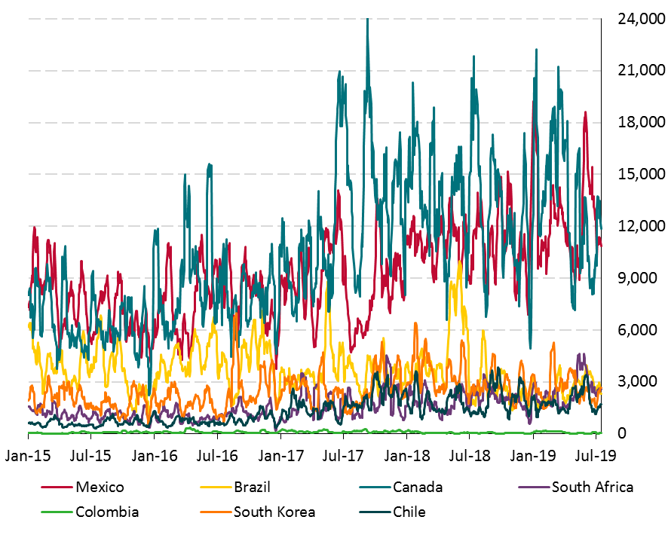
Primary Dealers System in Mexico: Development and Contributions
Derivatives market development
The development of the fixed income market laid the groundwork for other markets, such as the derivative market.
The interest rate swap market in Mexico is one of the most traded compared to other emerging markets.
Traded Volume of Mexican interest rate swaps
Millions of Mexican pesos
Traded Volume of Interest Rate Swaps (IRS) for selected countries
Millions of US dollars
Source: DTCC.
Source: DTCC.

Slide 28
Primary Dealers System in Mexico: Development and Contributions
Derivatives market development
A liquid and deep IRS market is paramount, as implied information regarding monetary policy can be obtained from these instruments.
Implied target rate in the TIIE swap curve
Percent
Implied target rate in TIIE interest rate swaps and Mexican peso
Pesos per dollar and percent
Source: PIP with calculations from Banco de Mexico.
Source: PIP with calculations from Banco de Mexico.

Slide 29
Primary Dealers System in Mexico: Development and Contributions
Market intelligence
With the purpose of having a more “complete picture” of market conditions, the Central Bank of Mexico maintains regular communication with market makers.
Daily
Quarterly
Face-to-face meetings that allow the Central Bank of Mexico to learn the practical and detailed experience of the market makers.
These consultations are usually done by telephone or chat.
Promote a direct information exchange with market actors
The objective is to improve the structure of the program by discussing:
The Central Bank of Mexico is kept informed about relevant developments in the market
Market color provided by market makers complements Central Bank’s analysis of the market dynamics.
Market structure and development
Enhancing transparency in the market
Protect investors
Reducing systemic risk
Design of the of obligations and privileges
Examples of the type of information provided by Market Makers
What types of counterparts the market makers have been dealing with
What kind of securities they have traded
The depth of market liquidity
Prices at which the investors are willing to subscribe
Volumes, the number of sellers and buyers.

Slide 30
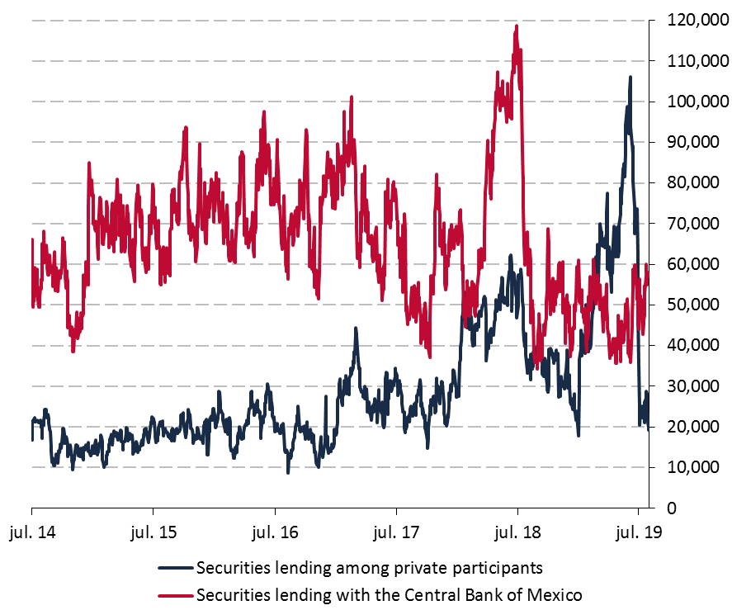
Primary Dealers System in Mexico: Challenges
Securities Lending
Securities lending operations are a key fundamental factor to develop the depth of fixed income and equity markets, and are commonly used in developed markets around the world.
Market makers in Mexico have access to a securities lending facility as a privilege.
As a result of implementing differentiated cost for the securities lending facility, from being practically inexistent at the beginning of 2008, the amount outstanding in securities lending has increased considerably.
Amount outstanding in Securities Lending (Mbonos and Inflation-linked bonds)
Millions of pesos
Source: Banco de México.

Slide 31
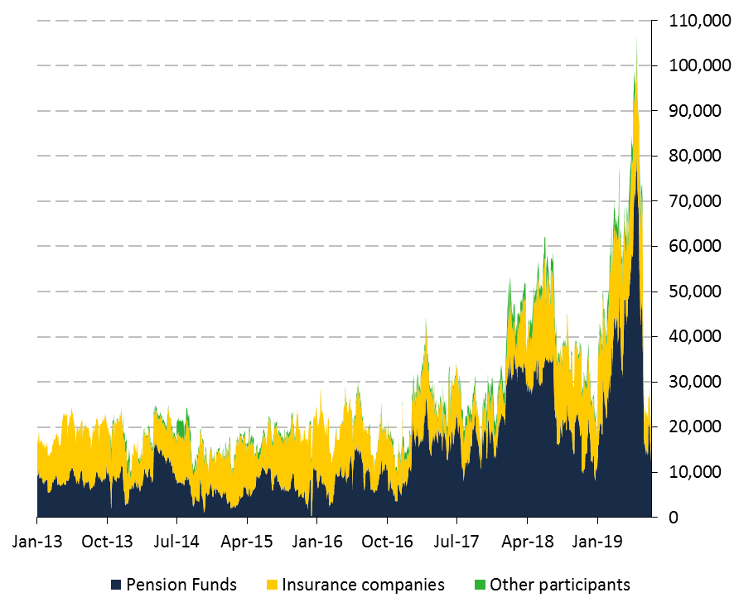
Primary Dealers System in Mexico: Challenges
Securities Lending
However, data shows that securities lending activity is still on initial stages in the local market, as the outstanding amount of loans with government securities represents only between 1% and 2% of the outstanding amount of government debt.
Private market participants are still reluctant to engage in securities lending activity among each other, and they prefer to perform this activity with the Central Bank. Pension Funds are the most active participants, although their lending activity is far from what they are capable of.
Securities Lending Daily Volume among private participants (Mbonos and Inflation-linked bonds)
Millions of pesos
Pension Fund’s Holdings and Securities Lending (Mbonos and Inflation-linked bonds)
Millions of pesos, percentage
Source: Banco de México.
Source: Banco de México.

Slide 32
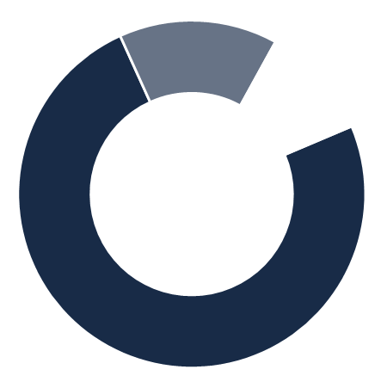
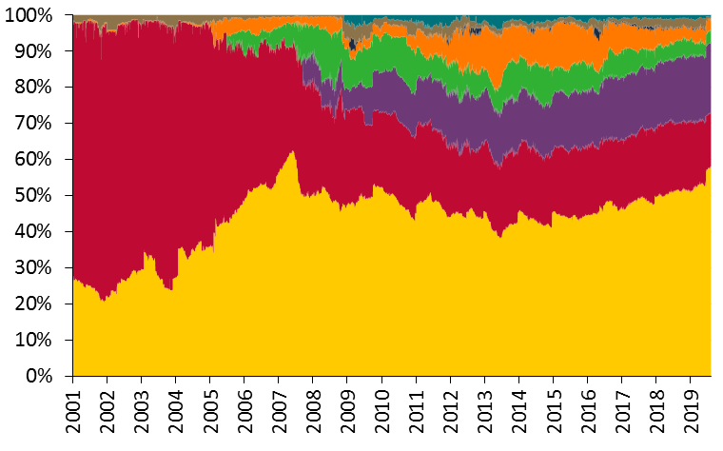
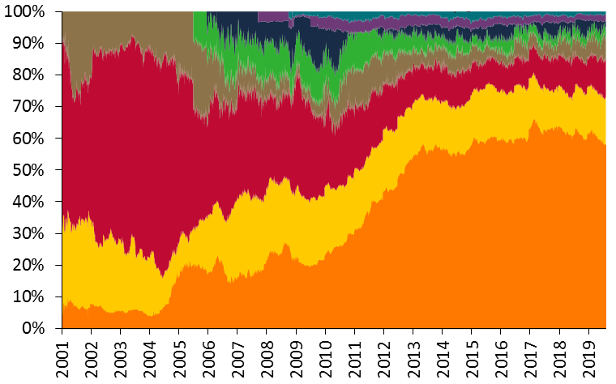
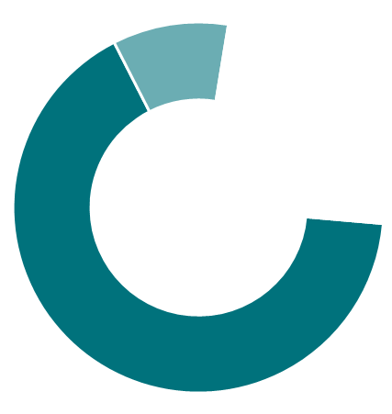
Primary Dealers System in Mexico: Challenges
Further development of the inflation-linked bonds market
As mentioned before, inflation-linked bonds (Udibonos) were included to the Market Makers Program in 2008. For many years, the status of market maker of Udibonos was conditioned by being a market maker for Bonos. In 2018, this condition was removed, allowing different institutions to participate in the Udibonos program.
Since inflation-linked bonds were included in the Market Makers Program, we have seen important improvements and development in this market.
However, trading volume, market conditions and investor base for inflation-linked bonds still have room for improvement compared to the nominal bonds market.
M BONOS
Daily Turnover of Bonos and Udibonos
Daily operations/outstanding amount (20-day moving average)
Number of Participants
Market Share
8
14.8%
7
89.4%
74.6%
Market Makers
Aspirants
Holdings of government securities by sector
UDIBONOS
Inflation-linked bonds
Percentage
Bonds
Percentage
Number of Participants
Market Share
4
10.1%
3
76.2%
66.1%
Market Makers
Aspirants
Source: Banco de México.

